Slide 1
Trusted Notifier Network: DotAsia Experience
2025.10.28 | GAC @ ICANN84, Dublin

Slide 2

DNS Abuse “Ecosystem”
Abuse
(gTLDs)
Within ICANN Remit
Beyond ICANN
Content
DNS
Infrastructure
Registration Data (WHOIS/ RDAP)
Other Internet/Web Apps & Platforms
Professional
Generated
Content
Registry System
EPP
Registrar System
Registrant
ISPs
End Users
gTLD DNS
Authoritative DNS Servers (Hosts)
DNS Resolvers
(ISPs)
User
Generated
Content
IANA Root DB
Root DNS
ccTLD DNS
Web & Email Hosting

Slide 3

Not DNS Abuses but TLD registries do have policies to mitigate against (e.g. UDRP & Rights Protection, CSAM, etc.)
Not DNS Abuses but TLD registries do have policies to mitigate against (e.g. UDRP & Rights Protection, CSAM, etc.)
Cyber Abuses
DNS Abuse
DNS Abuses within ICANN remit that TLD registries are to mitigate against (Phishing, malware, botnets, etc.)
Abuses appropriate for mitigation by Top Level Domain (TLD) Registries

Slide 4
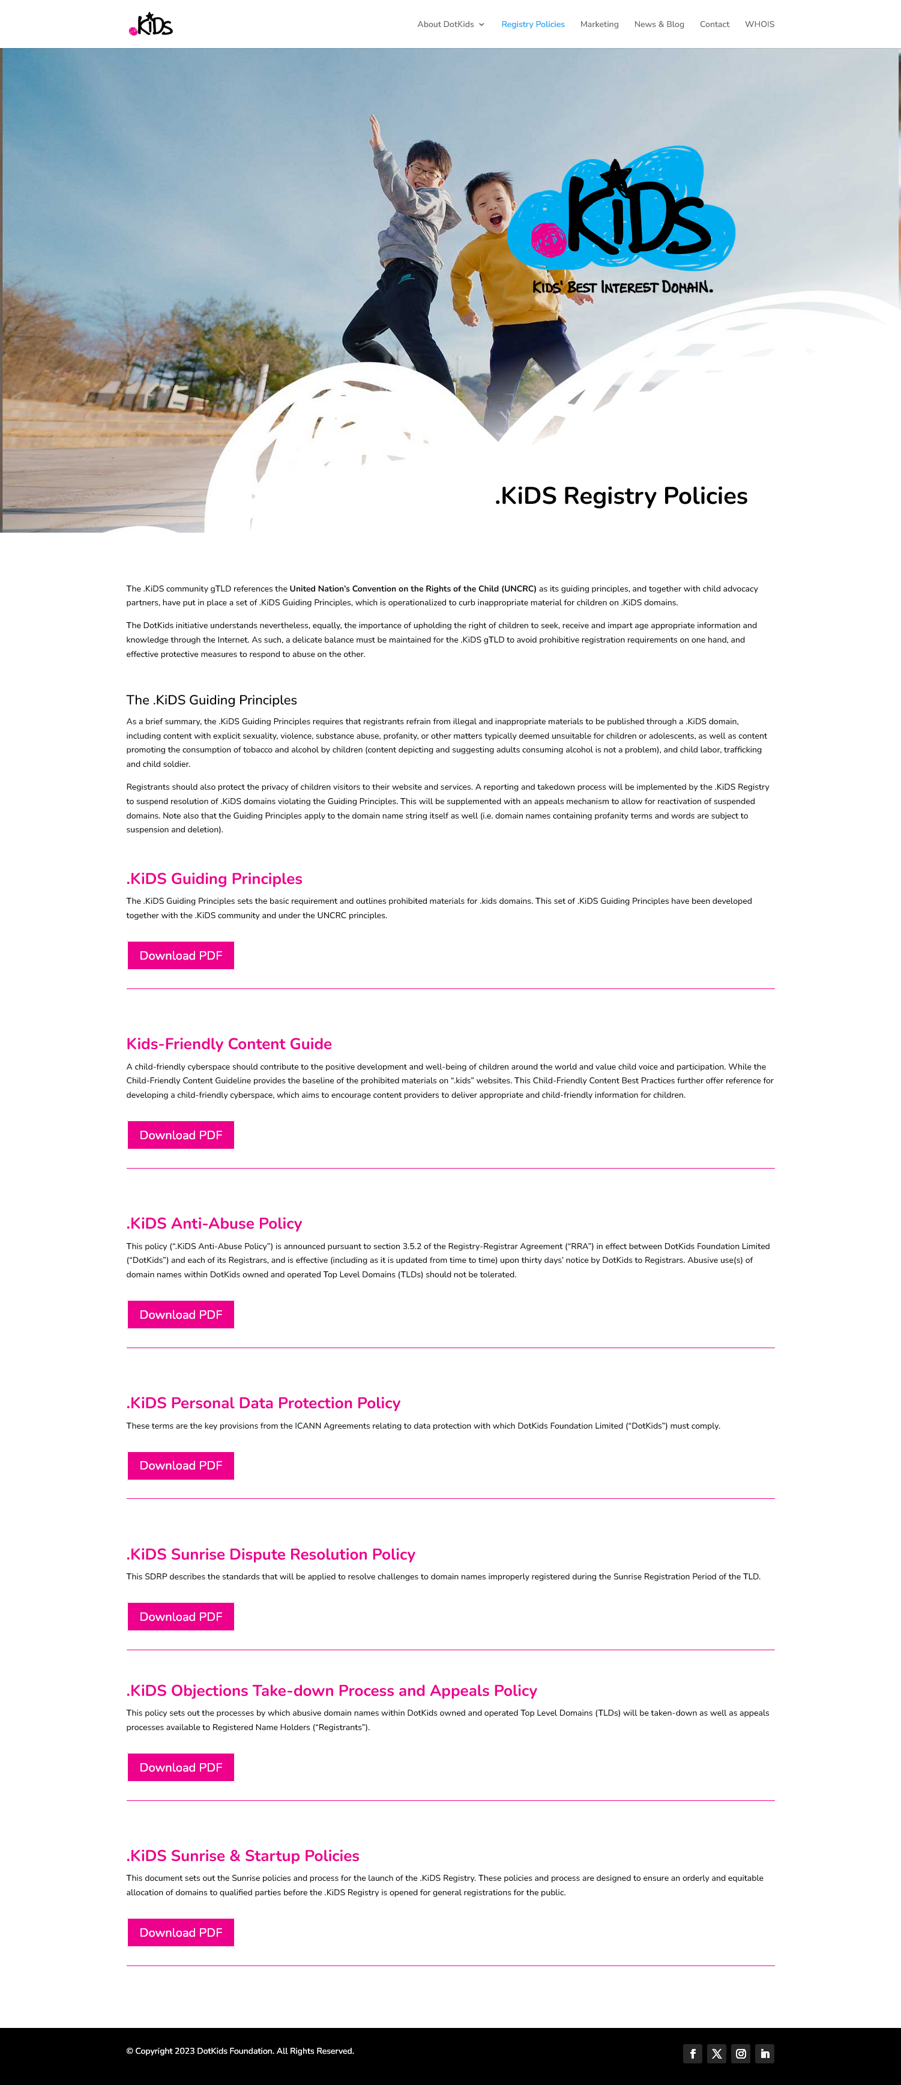

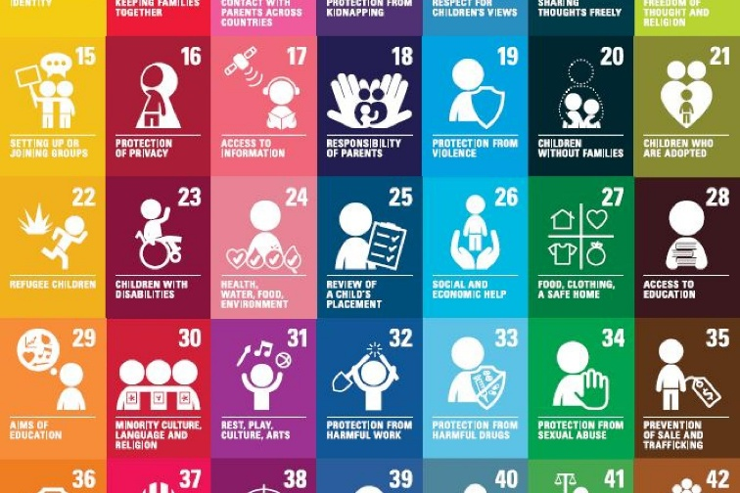

Slide 5
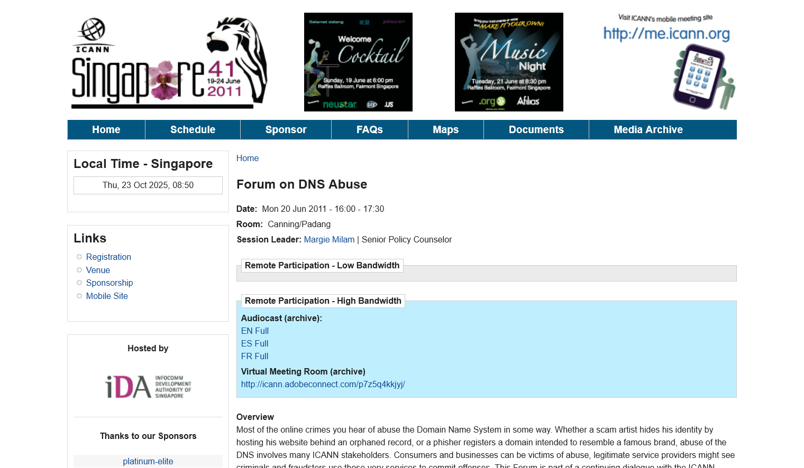

Slide 6
Trusted Notifier: DotAsia’s Current Approach
Registry-to-Registry
  Bilateral arrangements (.TW – TWNIC & .UK – Nominet)
  Similar level of sensitivity for Registry level domain suspension (on false positives, etc.)
  ccTLDs help add local dimension to detection of abuse (and national CERTs)
Expedited Suspension
  Trusted channel for submission
  Due diligence – documented evidence
Exploring Other Dimensions
  Beyond DNS Abuse (and ICANN Remit)
  CERT / CIRTs

Slide 7
Every .Asia Domain Contributes to Internet Development in Asia
Thank You! | info@dot.asia

Slide 8
Phishing
Malware
Malicious
Registrations
Compromised
Registrations
Botnets
Pharming
Spam
(as a vector)

